Slide 1


Slide 2
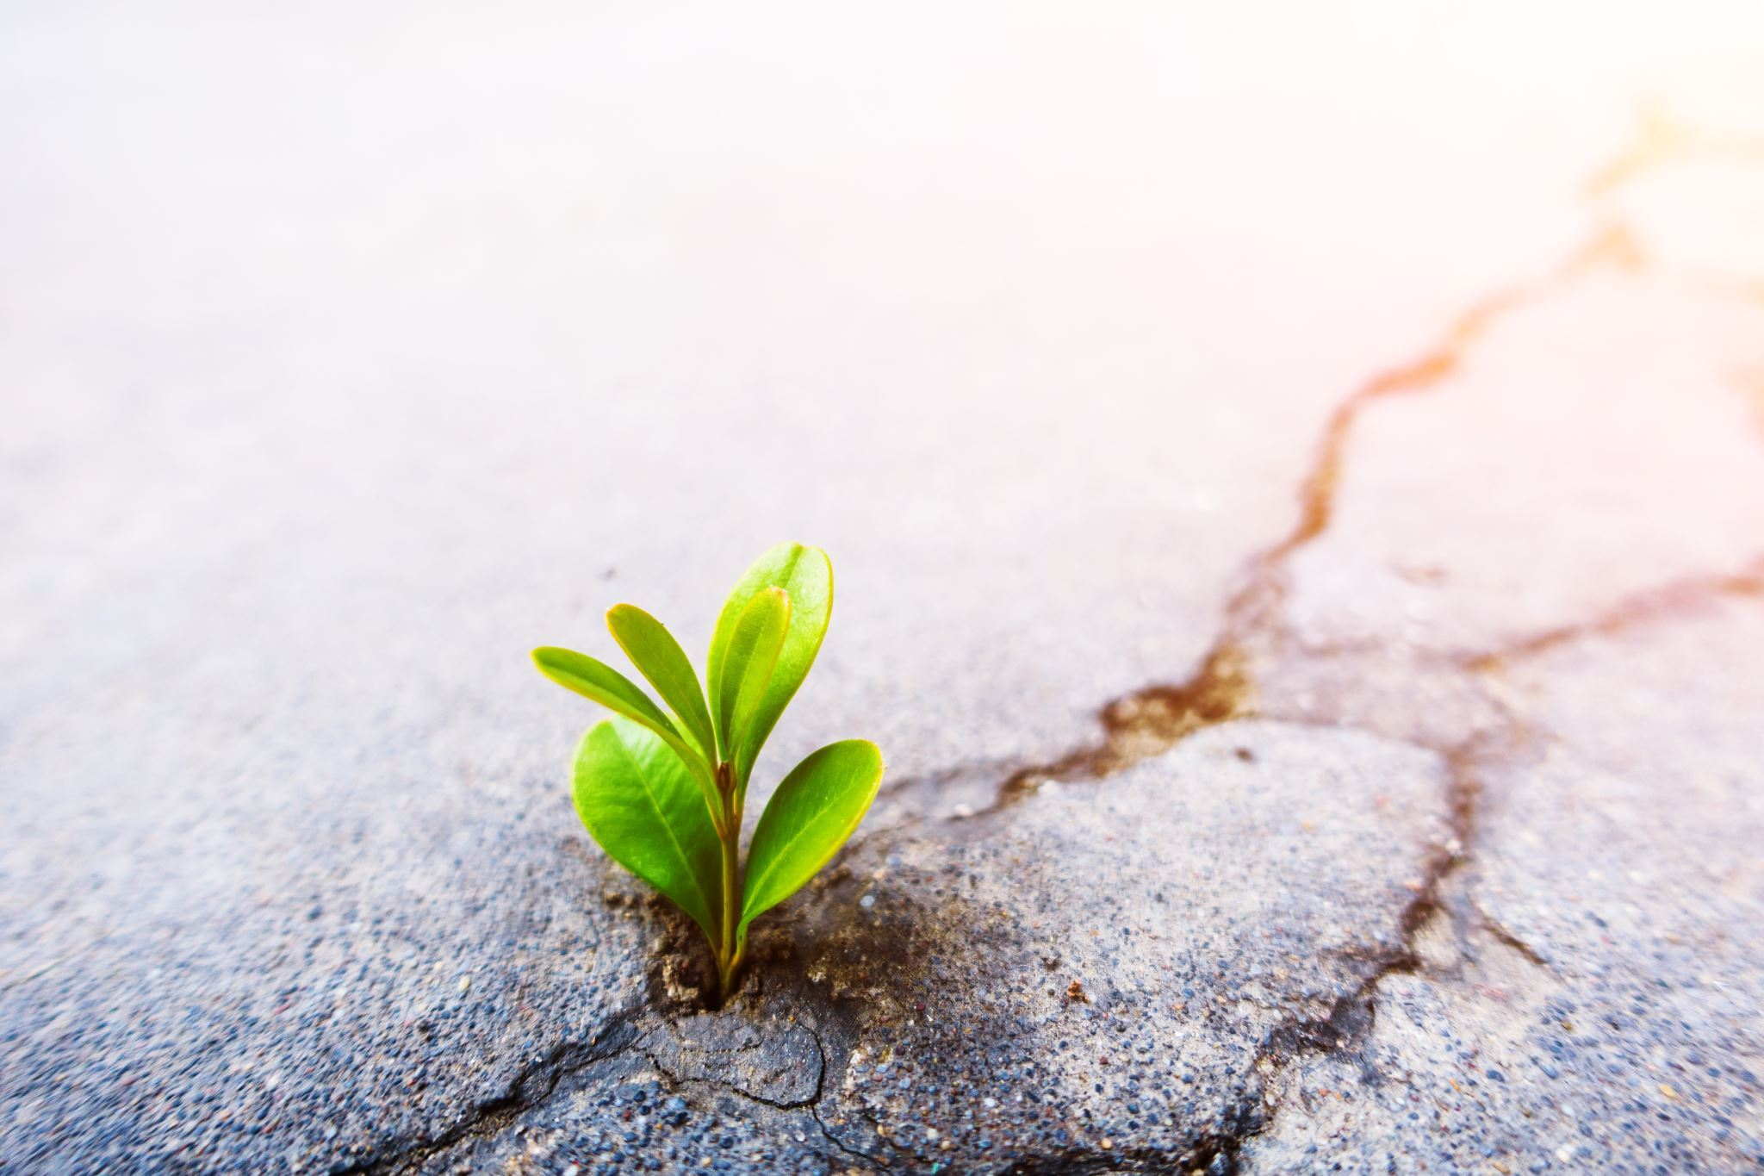
I. Introduction
A. Hook: Start with a compelling quote or anecdote about living life to the fullest
B. Thesis Statement: "Living Life Before You Die: Embracing the Journey of Personal Growth and Fulfillment."
C. Briefly explain the importance of living life to the fullest and introduce the main points

Slide 3
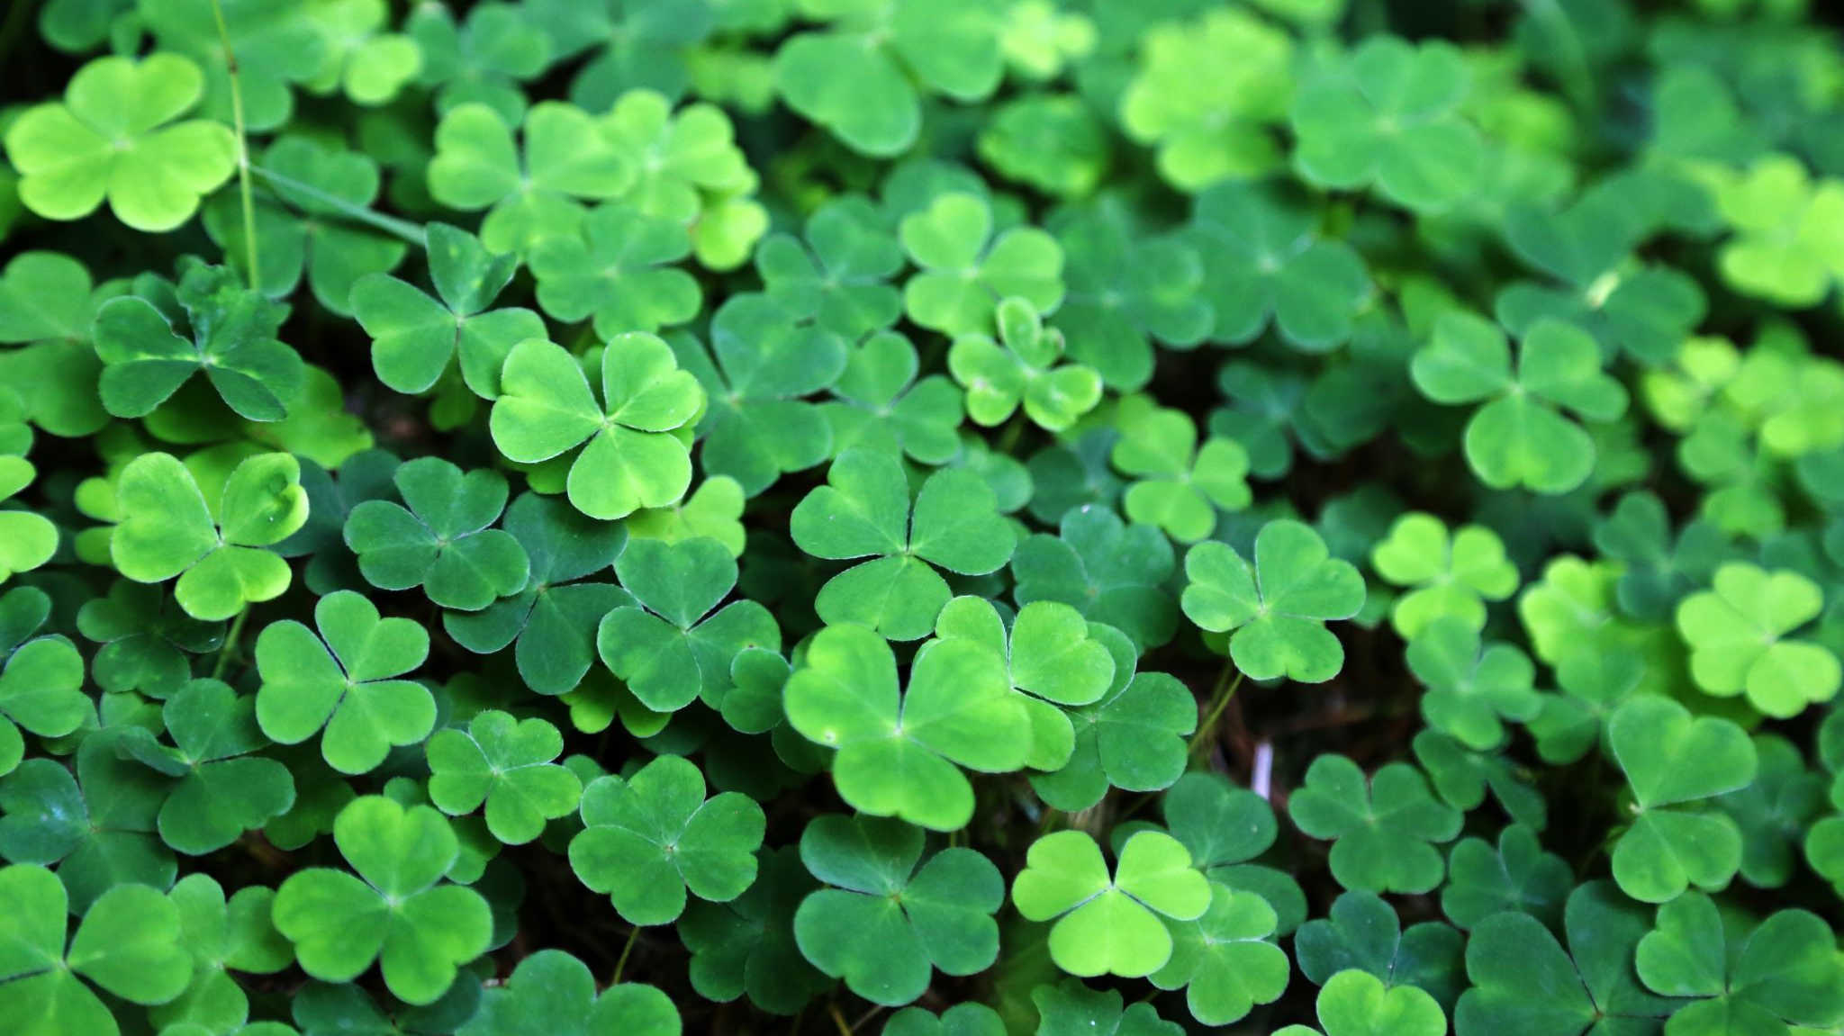
II. The Meaning of Life
A. Discuss different philosophical perspectives on the meaning of life
B. Explore the concept of existentialism and how it relates to living life before you die
C. Emphasize the idea that life's meaning is subjective and personal

Slide 4

III. Overcoming Fear and Taking Risks
A. Explain how fear can hold us back from experiencing life to the fullest
B. Discuss common fears and their impact on personal growth
C. Provide practical strategies for overcoming fear and embracing new experiences
D. Share inspiring stories of individuals who conquered their fears and achieved personal fulfillment

Slide 5

IV. Setting Meaningful Goals
A. Explain the importance of setting goals for personal growth and fulfillment
B. Discuss the characteristics of effective goals
C. Provide examples of different types of goals and their significance in living a fulfilling life
D. Offer practical tips for setting and achieving meaningful goals

Slide 6

V. Cultivating Mindfulness and Gratitude
A. Define mindfulness and its benefits in living a present and fulfilling life
B. Discuss the role of gratitude in enhancing well-being and appreciation for life
C. Offer practical exercises and techniques to cultivate mindfulness and gratitude in daily life

Slide 7
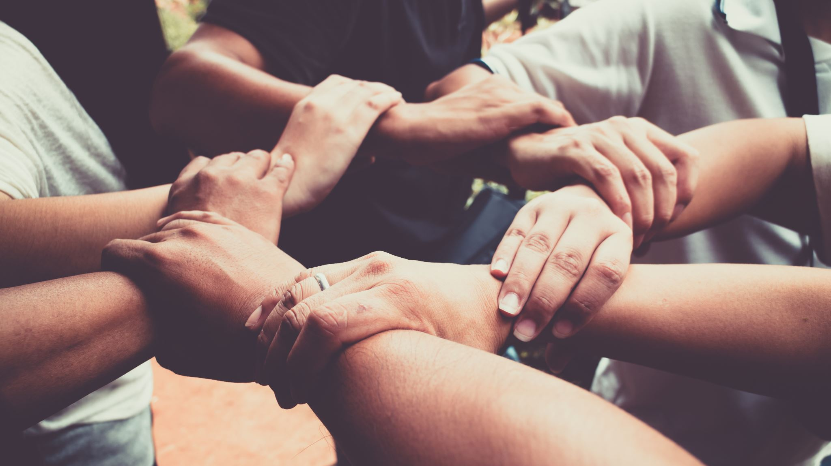
VI. Building Authentic Relationships
A. Emphasize the importance of meaningful connections and relationships
B. Discuss the qualities of authentic relationships
C. Provide strategies for building and nurturing genuine connections with others
D. Share personal stories or examples that highlight the impact of authentic relationships on living a fulfilling life

Slide 8
VII. Embracing Personal Growth and Learning
A. Explain the connection between personal growth and living life to the fullest
B. Discuss the benefits of lifelong learning and continuous self-improvement
C. Offer suggestions for personal growth activities and how they contribute to a fulfilling life

Slide 9

VIII. Embracing the Present Moment
A. Discuss the tendency to focus on the past or future and its impact on living fully
B. Explore the concept of mindfulness and its role in embracing the present moment
C. Provide practical strategies for staying present and savoring the small joys in life

Slide 10
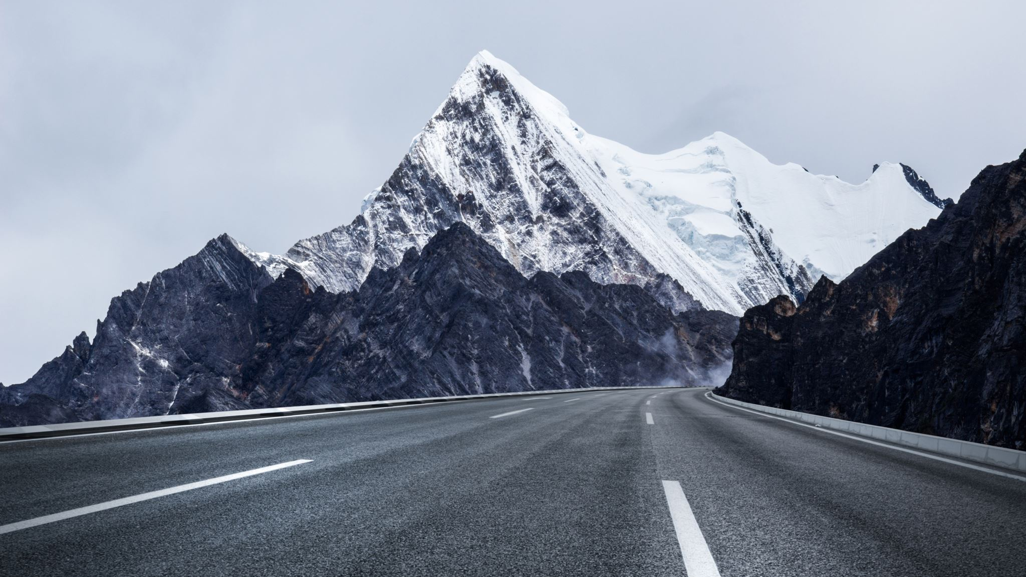
IX. Conclusion
C. End with an inspiring quote or call to action, encouraging the audience to embrace the journey of personal growth and fulfillment

